Slide 1
Match Pair
A memory testing game

Slide 2
Group Members:
Ambia Hossain 011 143 114
Md. Tawab Alam Khan 011 143 127

Slide 3
Introduction
Match pair is a memory testing game which consists of 4x4 grid.
Each grid contains a single square.
Every square has a common color on one side and four different colors on the other side.
Pressing the space bar will rotate the selected square and will let the player see the color on the opposite side.
Player has to match the square of same color.

Slide 4
Individual contribution
Ambia Hossain-
Grid layout design
User interaction
Md. Tawab Alam Khan-
Animation
Game logic design

Slide 5
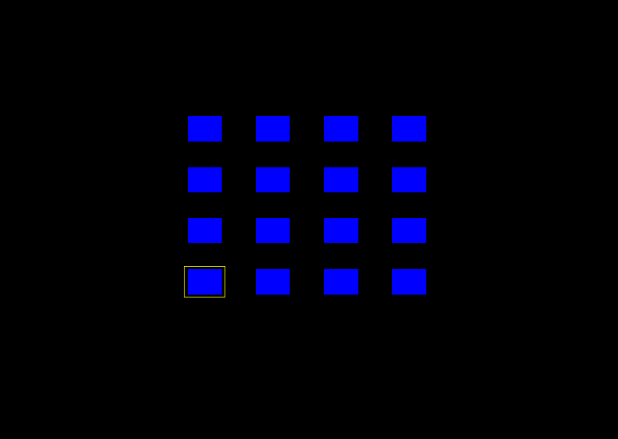
Screenshot

Slide 6
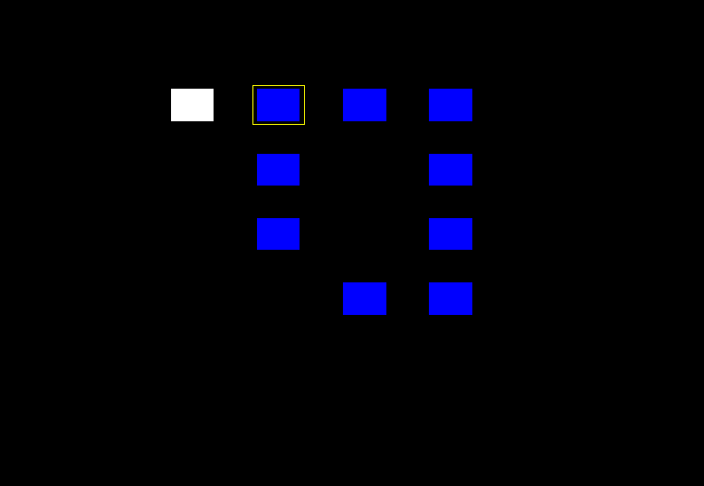

Slide 7
Thank You

